Slide 1
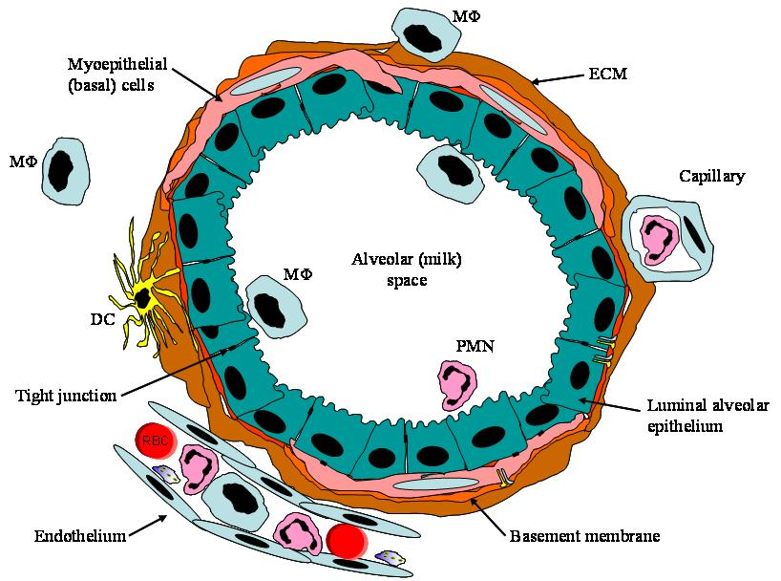
Integrated immunological and metabolic responses of the mammary gland to LPS challenge in bovine
Nissim Silanikove^{1*}, Adi Rauch-Cohen¹ and Gabriel Leitner²
1 Biology of Lactation Laboratory, Institute of Animal Science, the Volcani Center, P.O.B. 6, Bet Dagan 50250, Israel, 2 Kimaron Veterinary Institute, National Mastitis Center, POB 12, Bet Dagan

Slide 2
Effect of lactation on metabolism
The production of milk in intensive producing systems (40 to 70 litters per day in counties such as Israel and the US) encountered for ~ 70-80% of the whole animal metabolizable energy intake
which is reflected by similar proportion of extraction of the whole body glucose production

Slide 3
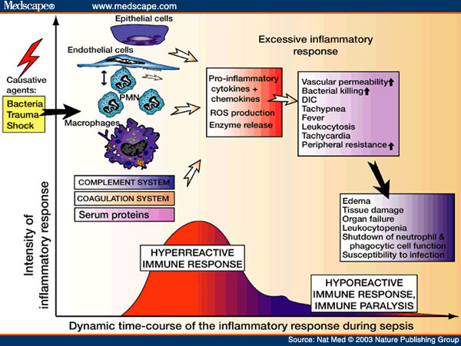
Bacteria (E. Coli) infection may imposes a life threatening situation

Slide 4
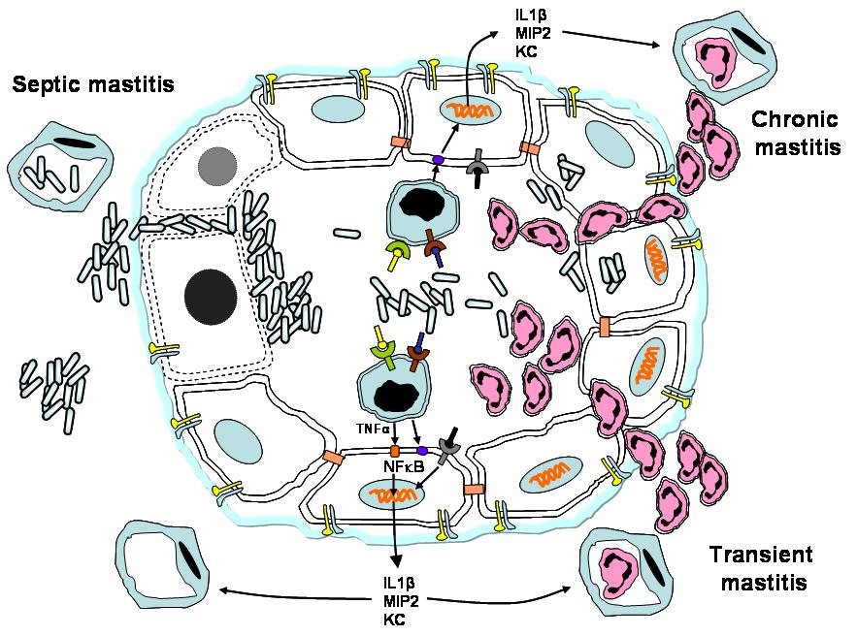
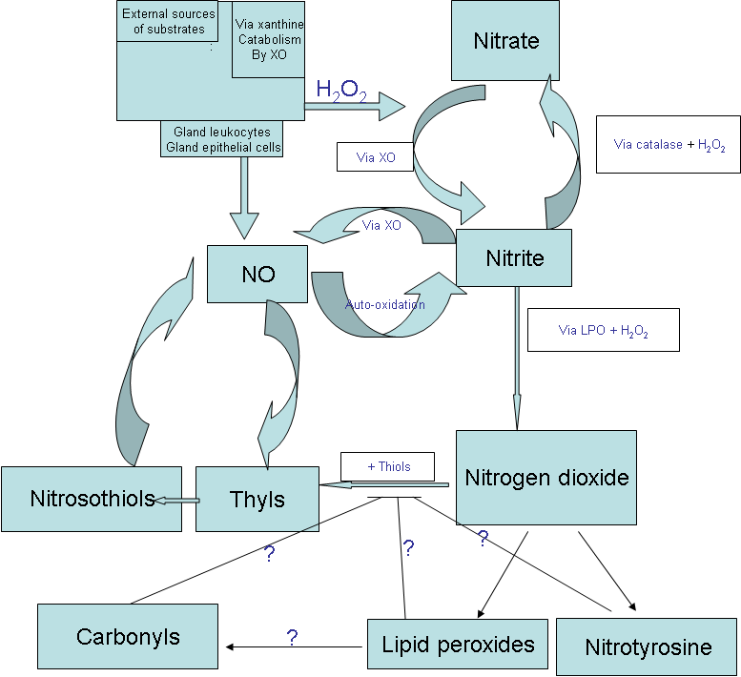
it is well established that Immune response requires considerable proportion of mammalian energy and metabolite resources

Slide 5
The general aim of this study was to test hypothesize that the diverse metabolic and immune responses of the mammary gland to LPS challenge describe an integrated mechanism that fights against Gram negative

Slide 6
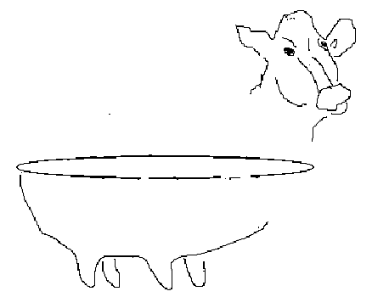
METHODOLOGY
Effect of LPS: 6 cows served as control, in second set of six cows one of the front and one rear glands were treated with LPS (10 ml with 10 µg/ ml LPS) while the contra-lateral glands served as running control. The cows milk were sampled at -24h, 0 h (before treatment) and 24, 48 and 76 h post-treatment.
The data were analyzed for the effect of treatment and time at a single gland level
+
-

Slide 7
Effect of LPS on milk yield

Slide 8
Effect of LPS on lactose concentration

Slide 9
Effect of LPS lactoferrin concentration

Slide 10
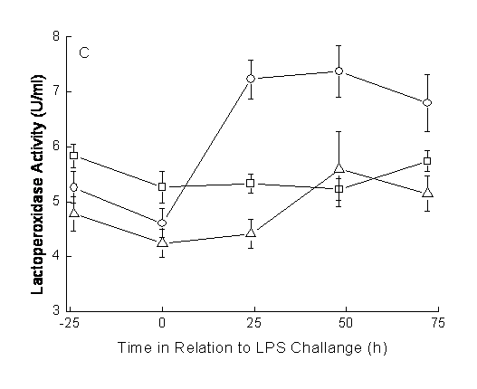
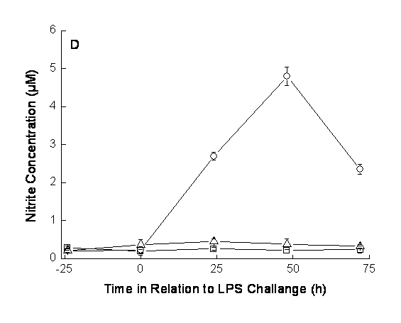
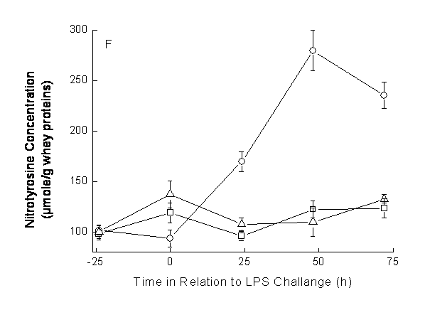
Effect of LPS on LPO activity, nitrite and nitrotyrosine
concentrations

Slide 11
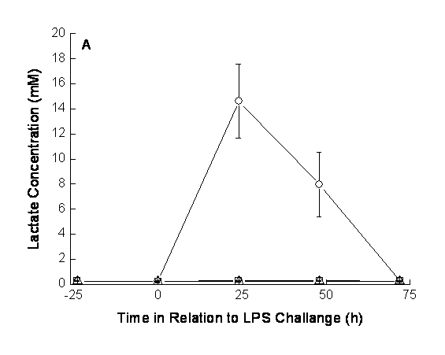
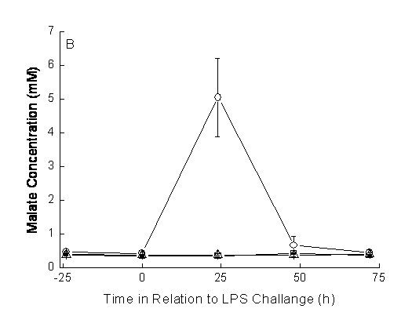
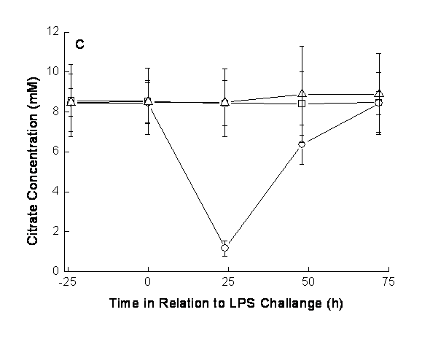
Novel findings: Effect of LPS on lactate, malate and citrate
concentrations

Slide 12
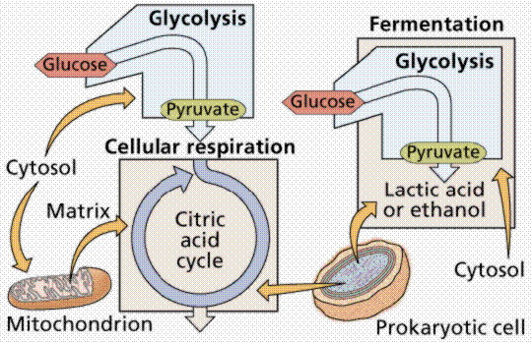
Cytosolic and mitochondrial glycolysis

Slide 13
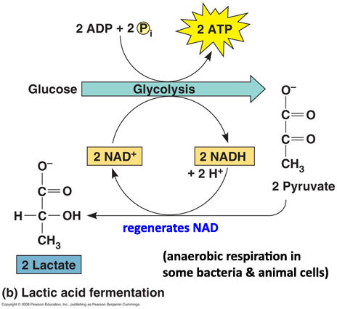
Lactic acid metabolism

Slide 14
Cytosolic formation of malic acid

Slide 15
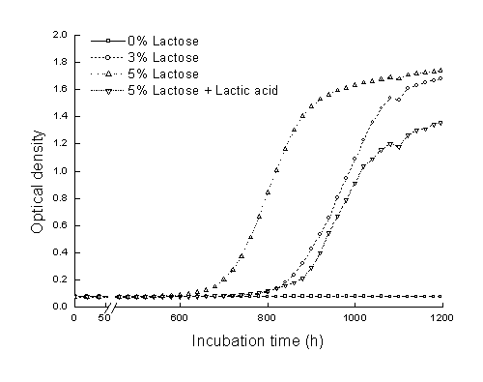
Low lactose and high lactic acid in broth media affect the growth of pathogenic type of E coli
JA C Q U E S M O N O D
From enzymatic adaptation to
allosteric transitions
Nobel Lecture, December 11, 1965

Slide 16
The Main Conclusion
The acute conversion of the epithelial cells metabolism from principally mitochondrial-oxidative to principally cytosolic (glycolysis) allows the diversion of metabolic resources normally used to synthesize milk to support the immune system. In turn, the acute increase in the concentration of lactate and malate in milk and the parallel reduction in lactose concentration are probably effective mean in restraining invading E Coli growth.

